Slide 1
Protection

Slide 2
Protection
Mechanism for controlling the access of programs, processes or users to the resources defined by a computer system
Provide a means of specification of controls(policies) and means of enforcement of policies governing resource use
Prevent mischievous, intentional violation of an access restriction by a user.

Slide 3
Goals of Protection
Operating system consists of a collection of objects, hardware or software
Each object has a unique name and can be accessed through a well-defined set of operations.
Protection problem - ensure that each object is accessed correctly and only by those processes that are allowed to do so.

Slide 4
Principles of Protection
Guiding principle – principle of least privilege
Programs, users and systems should be given just enough privileges to perform their tasks

Slide 5
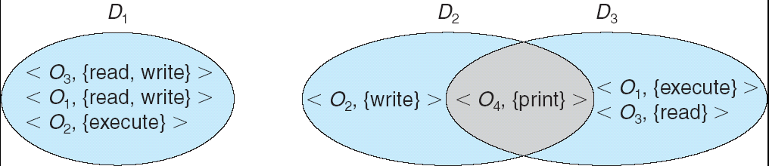
Domain Structure
A process operates within a protection domain
Access-right = <object-name, rights-set> where rights-set is a subset of all valid operations that can be performed on the object.
Domain = set of objects with access-rights

Slide 6
Need-to-know principle
The association between a process may be either static or dynamic
A domain may be realized as
User
Process
procedure

Slide 7
Domain Implementation (UNIX)
System consists of 2 domains:
User
Supervisor
UNIX
Domain = user-id
Domain switch accomplished via file system
Each file has associated with it a domain bit (setuid bit)
When file is executed and setuid = on, then user-id is set to owner of the file being executed. When execution completes user-id is reset

Slide 8
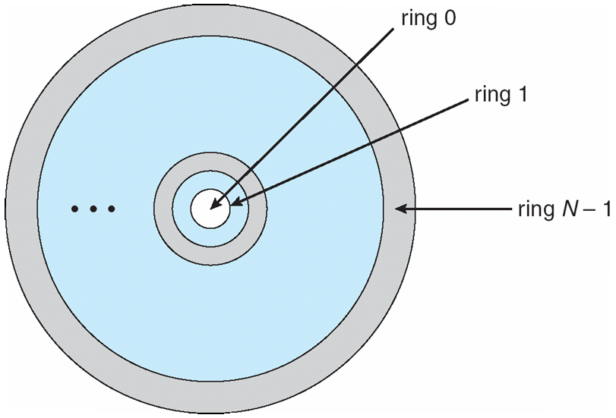
Domain Implementation (MULTICS)
Let D_{i} and D_{j} be any two domain rings
If j < I ⇒ D_{i} ⊆ D_{j}

Slide 9
Access Matrix
View protection as a matrix (access matrix)
Rows represent domains
Columns represent objects
Access(i, j) is the set of operations that a process executing in Domain_{i} can invoke on Object_{j}

Slide 10
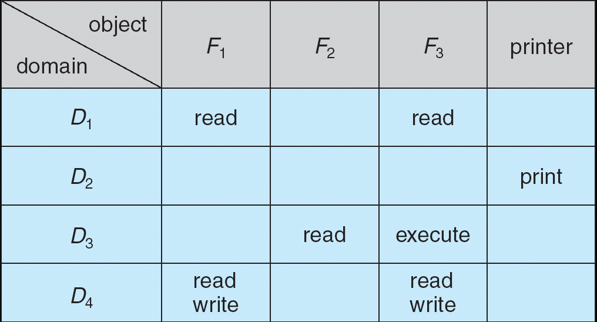
Access Matrix
Figure A

Slide 11
Use of Access Matrix
If a process in Domain D_{i} tries to do “op” on object O_{j}, then “op” must be in the access matrix.
Can be expanded to dynamic protection.
Operations to add, delete access rights.
Special access rights:
owner of O_{i}
copy op from O_{i} to O_{j}
control – D_{i} can modify D_{j} access rights
transfer – switch from domain D_{i} to D_{j}

Slide 12
Use of Access Matrix (Cont.)
Access matrix design separates mechanism from policy.
Mechanism
Operating system provides access-matrix + rules.
If ensures that the matrix is only manipulated by authorized agents and that rules are strictly enforced.
Policy
User dictates policy.
Who can access what object and in what mode.

Slide 13
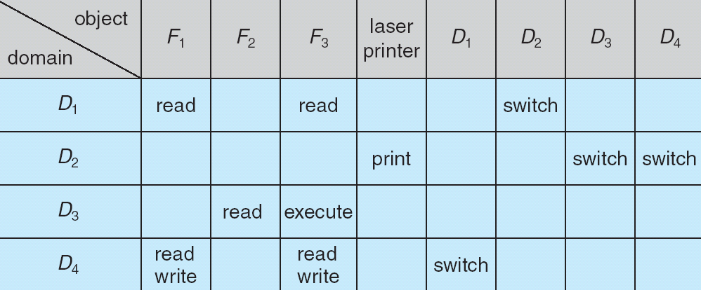
Access Matrix of Figure A With Domains as Objects
Figure B

Slide 14
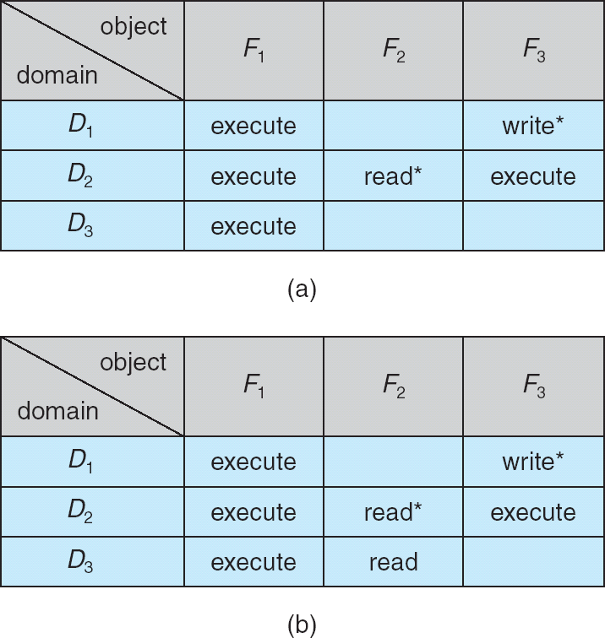
Access Matrix with Copy Rights

Slide 15
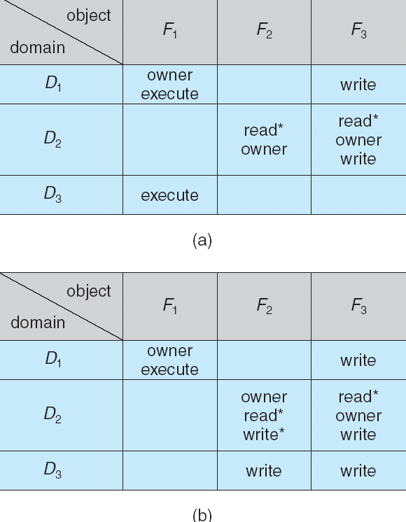
Access Matrix With Owner Rights

Slide 16
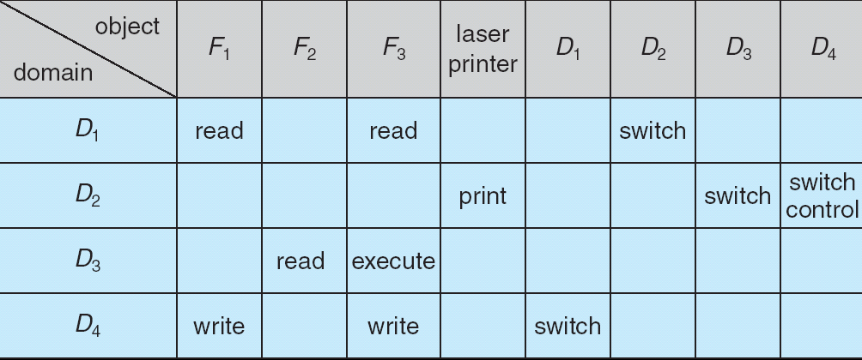
Modified Access Matrix of Figure B

Slide 17
Implementation of Access Matrix
Global Table
Consists of a set or ordered triples<domain,object, right-set>
Access lists for objects
Each column in the access matrix is implemented as an access list for one object
Capability lists for domains
A lock-key Mechanism

Slide 18
Access Control
Protection can be applied to non-file resources
Solaris 10 provides role-based access control (RBAC) to implement least privilege
Privilege is right to execute system call or use an option within a system call
Can be assigned to processes
Users assigned roles granting access to privileges and programs

Slide 19
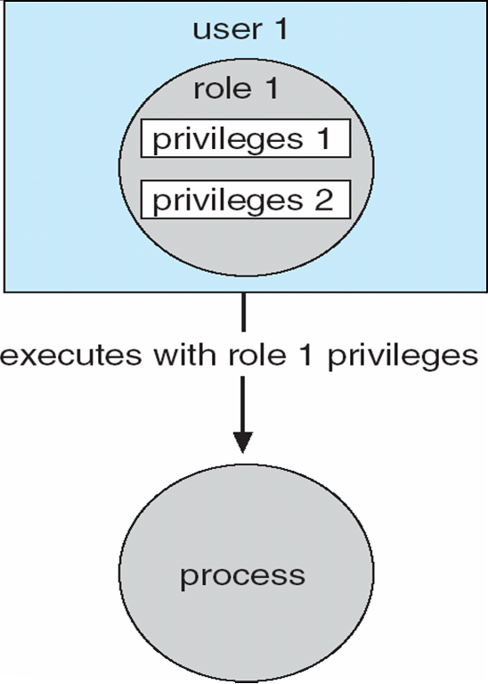
Role-based Access Control in Solaris 10

Slide 20
Implementation of Access Matrix
Each column = Access-control list for one object Defines who can perform what operation. Domain 1 = Read, Write Domain 2 = Read Domain 3 = Read 
Each Row = Capability List (like a key) Fore each domain, what operations allowed on what objects.
Object 1 – Read
Object 4 – Read, Write, Execute
Object 5 – Read, Write, Delete, Copy

Slide 21
Revocation of Access Rights
Access List – Delete access rights from access list
Simple
Immediate
Capability List – Scheme required to locate capability in the system before capability can be revoked
Reacquisition
Back-pointers
Indirection
Keys

